Slide 1


365DataScience
Presented By : Neha Yasmin
Last Updated : December 16, 2022

Slide 2
Contents
Objective
Sharing insights from the analysis.
Conclusion
Future Scope of the analysis.
Performing EDA on 365DataScience dataset.
Result of Analysis
The outcome of the analysis.

Slide 3
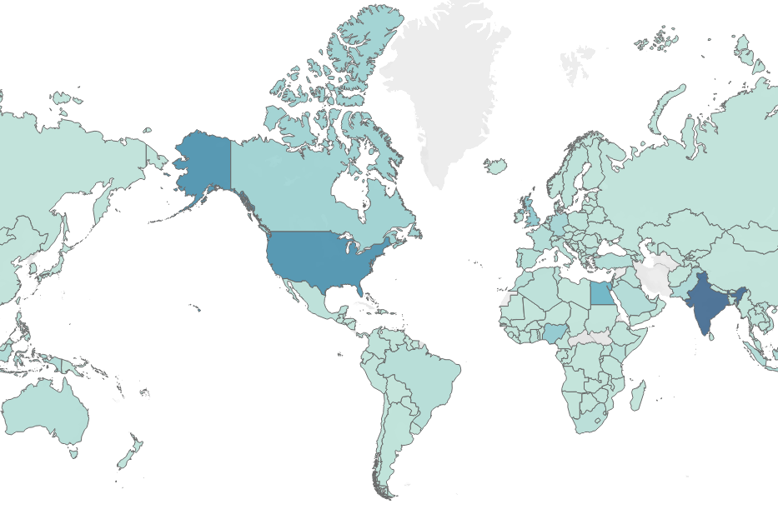
Students
The map shows 365DataScience students across different countries.
Maximum number of students are from India followed by United States and England.

Slide 4
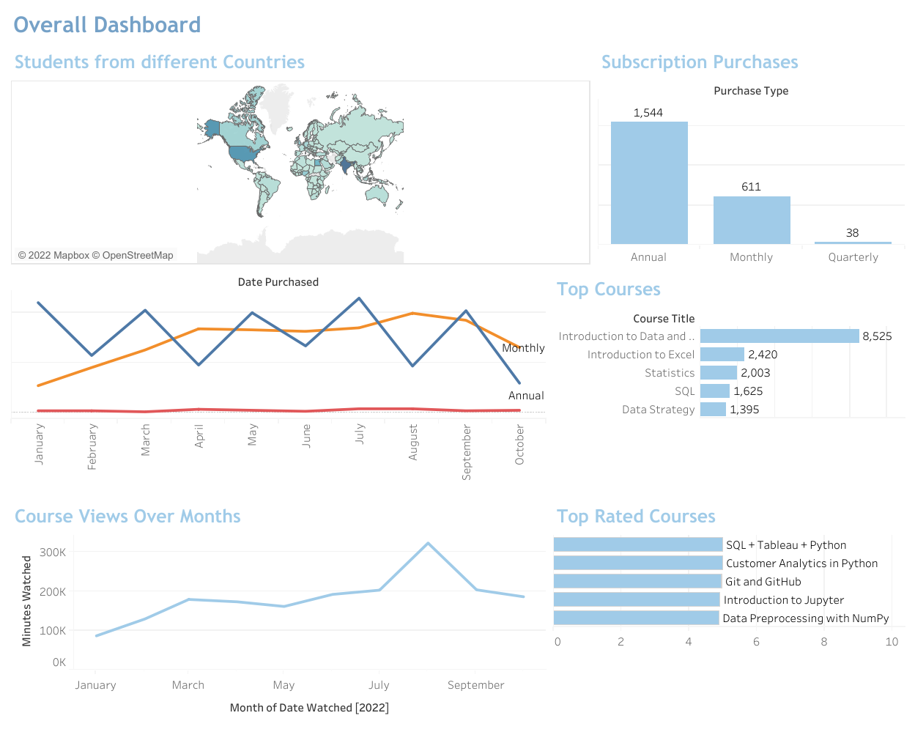
Courses
The Bar Chart shows the most enrolled courses.
The number written in front of each bar shows the number of student enrolled in that course.
These courses are also most recommended ones in their website.

Slide 5
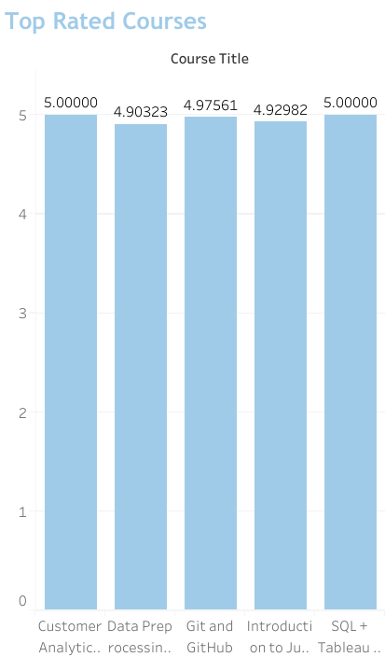
Best Rated Courses
None of the best rated courses are among the top courses of 365DataScience.
Also, they are not suggested to the students on the website as much as their top enrolled courses.

Slide 6
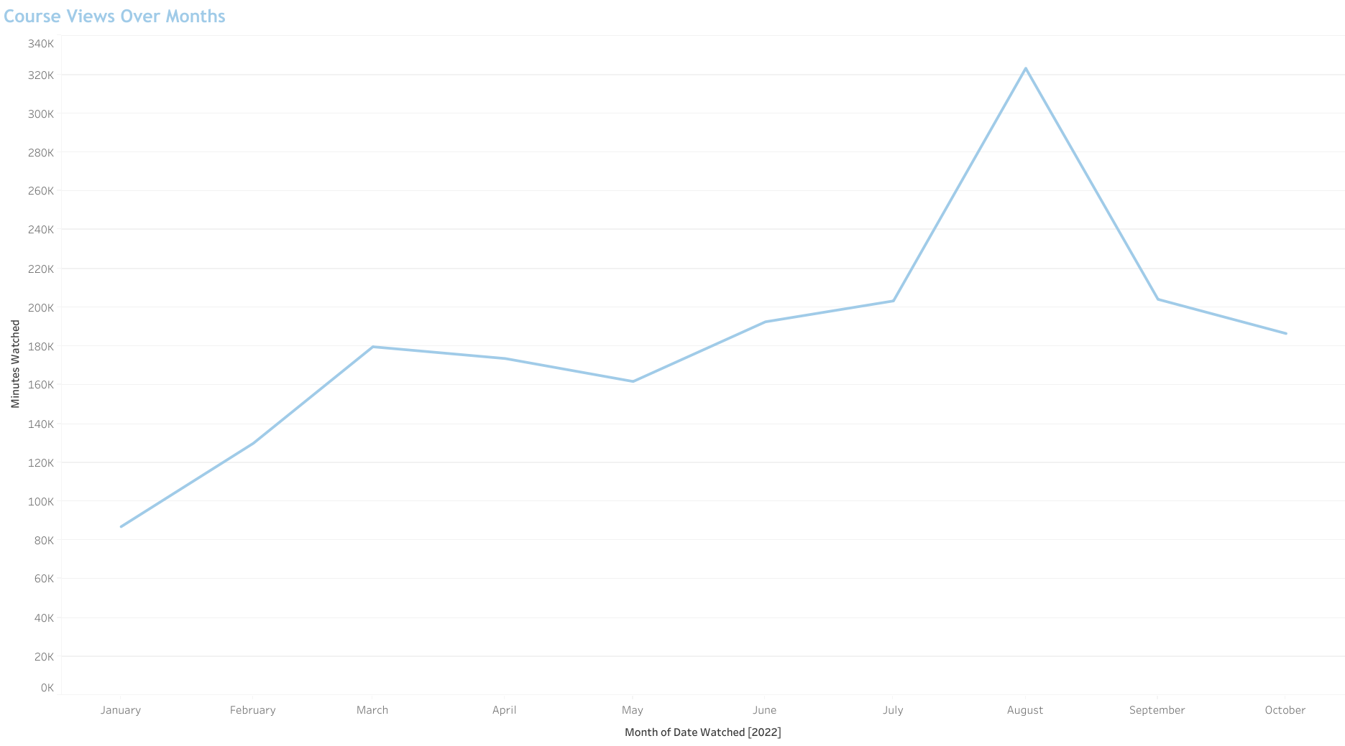
Monthly Views
The line chart shows the monthly course views on their website.
February, March, August shows the highest growth whereas September shows the decline in the views.

Slide 7
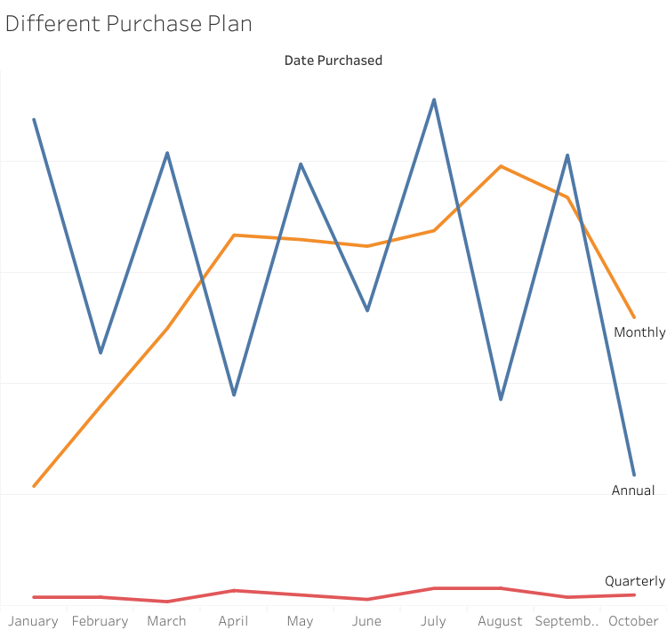
Subscription
The line chart shows different subscription plan purchases by different students over months.
The annual subscription plan is purchased the most by the students followed by monthly subscription.

Slide 8
Conclusion
Successfully performed EDA on the given dataset
There exist no relationship between top enrolled courses and the best selling courses.
Only 6.06% students purchased subscription.
This analysis doesn’t answer the ‘why’ questions due to the limitations of the dataset.
Additional analysis is done in the attached SQL file.

Slide 9
Thank You

